Slide 2

Agenda
Introduction to Xamarin
Cross Platform UI with Xamarin.Forms
Connected Apps with Azure
Lunch – Courtesy of Sponsor
File -> New App Workshop

Slide 3


Slides, Demos, & Lab - Clone or Download:
http://github.com/xamarin/dev-days-labs

Slide 4
Native iOS & Android Development with Xamarin
Presenter Name
Presenter Twitter
Presenter Title

Slide 5
Architecting Mobile Apps
Notes:
So we know what we want how do we get there? Let’s talk about the state of mobile development.

Slide 6

Xamarin’s Unique Approach
iOS C# UI
Android C# UI
Windows C# UI
Shared C# Mobile
Shared C# codebase • 100% native API access • High performance

Slide 7
Windows APIs
Microsoft.Phone
Microsoft.Networking
Windows.Storage
Windows.Foundation
Microsoft.Devices
System.Net
System
System.IO
System.Linq
System.Xml
System.Data
System.Windows
System.Numerics
System.Core
System.ServiceModel
C#

Slide 8
iOS – 100% API Coverage
MapKit
UIKit
iBeacon
CoreGraphics
CoreMotion
System.Net
System
System.IO
System.Linq
System.Xml
System.Data
System.Windows
System.Numerics
System.Core
System.ServiceModel
C#

Slide 9
Android – 100% API Coverage
Text-to-speech
ActionBar
Printing Framework
Renderscript
NFC
System.Net
System
System.IO
System.Linq
System.Xml
System.Data
System.Windows
System.Numerics
System.Core
System.ServiceModel
C#

Slide 10
Building User Interfaces
Notes:
So we know what we want how do we get there? Let’s talk about the state of mobile development.

Slide 11



Traditional UI approach
iOS C#
Android C#
Windows C#
Shared C# Logic
3 Native User Interfaces
Shared App Logic

Slide 12
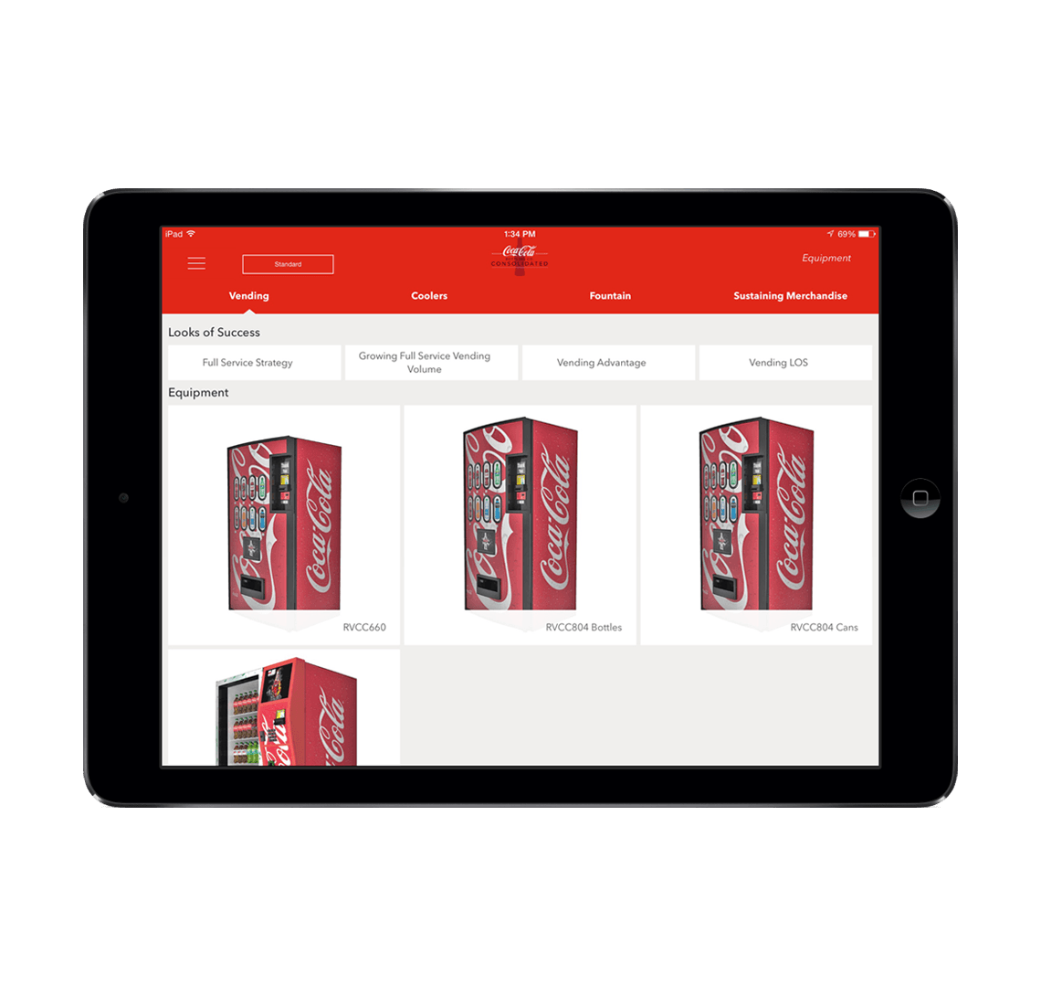
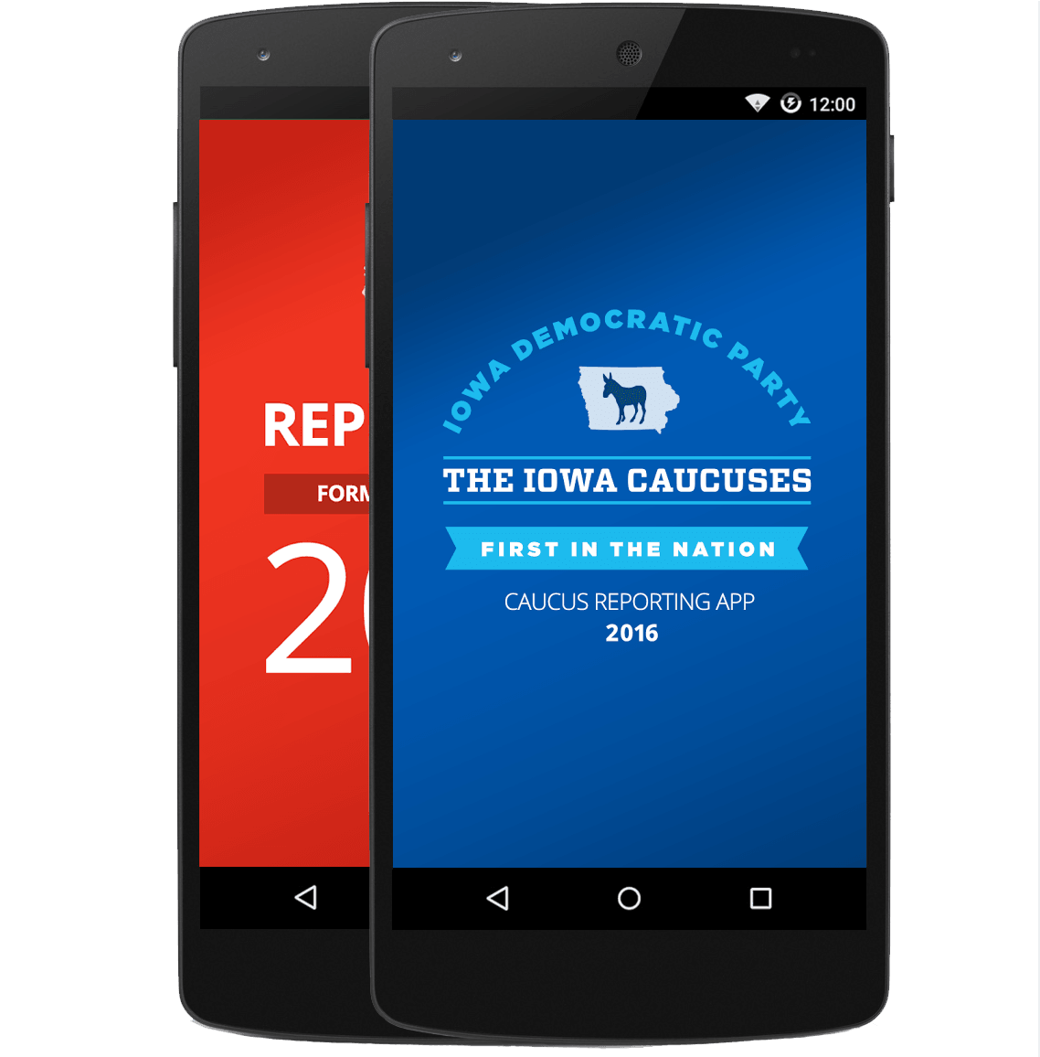
Xamarin.Forms approach
Shared UI Code
Shared C# Logic
Shared User Interface
Shared App Logic

Slide 13
UrhoSharp
CocosSharp
Notes:
Many popular and powerful game engines already leveraging C# are lifted by Mono runtime move to MIT license

Slide 14
Code sharing stats
iCircuit
Touch Draw
Android
iOS
Mac
Windows

Slide 15
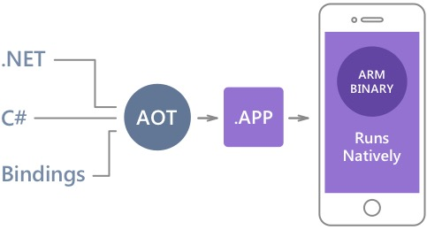
Native Performance
Xamarin.iOS does full Ahead Of Time (AOT) compilation to produce an ARM binary for Apple’s App Store.
Xamarin.Android takes advantage of Just In Time (JIT) compilation on the Android device.

Slide 16
✓Always Up-to-Date
Same-day support:
iOS 5
iOS 6
iOS 7
iOS 8
iOS 9
iOS 10
Full support for:
Apple Watch
Android Wear
Amazon Fire TV
Google Glass
and much more

Slide 17
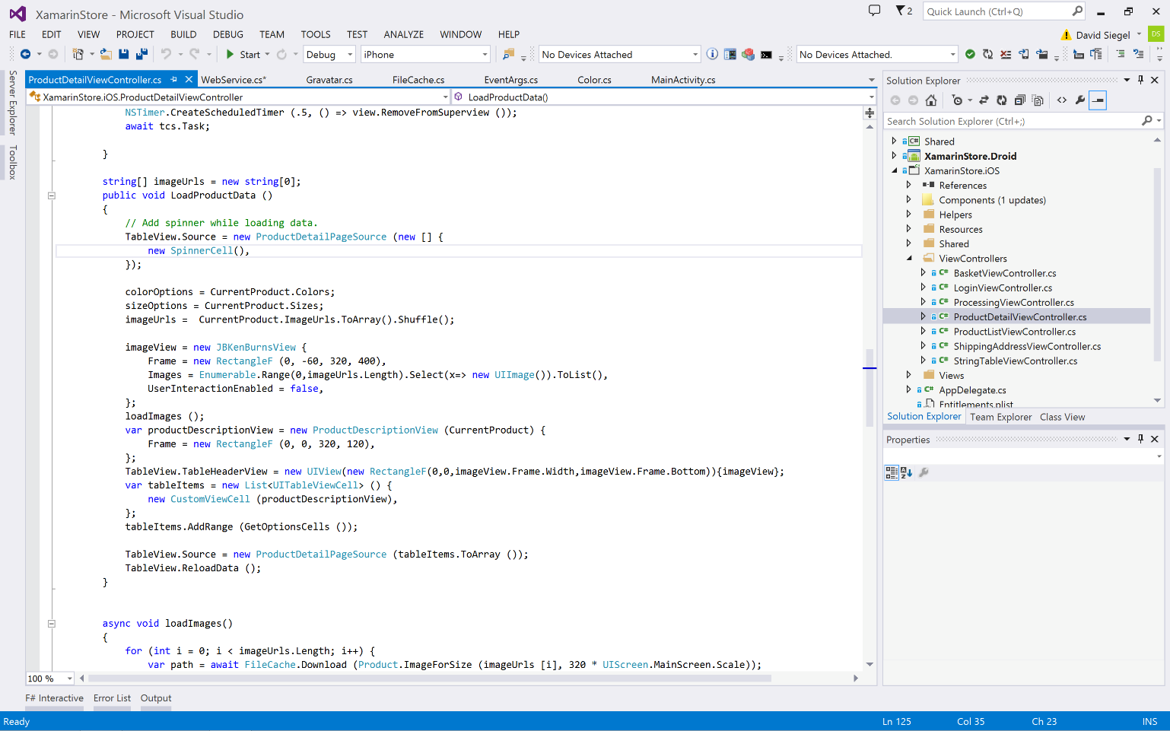
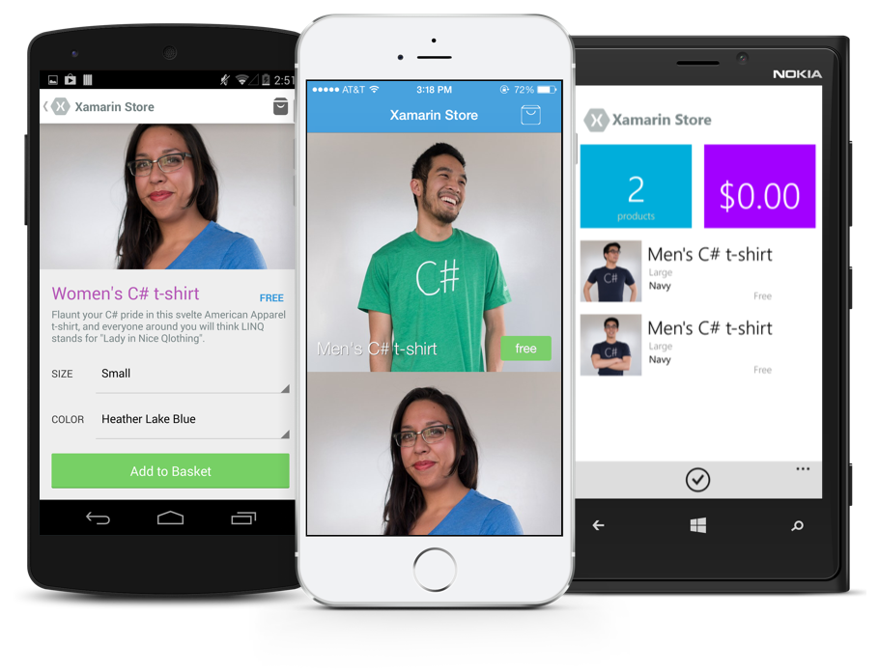
Anything you can do in Objective-C, Swift, or Java can be done in C# with Xamarin.
Notes:
Coming up next is bubbles

Slide 18
Let’s Build an App

Slide 19
Development Experience

Slide 20
Xamarin is included in Visual Studio
Xamarin is included
in Visual Studio
Including Community Edition!

Slide 21
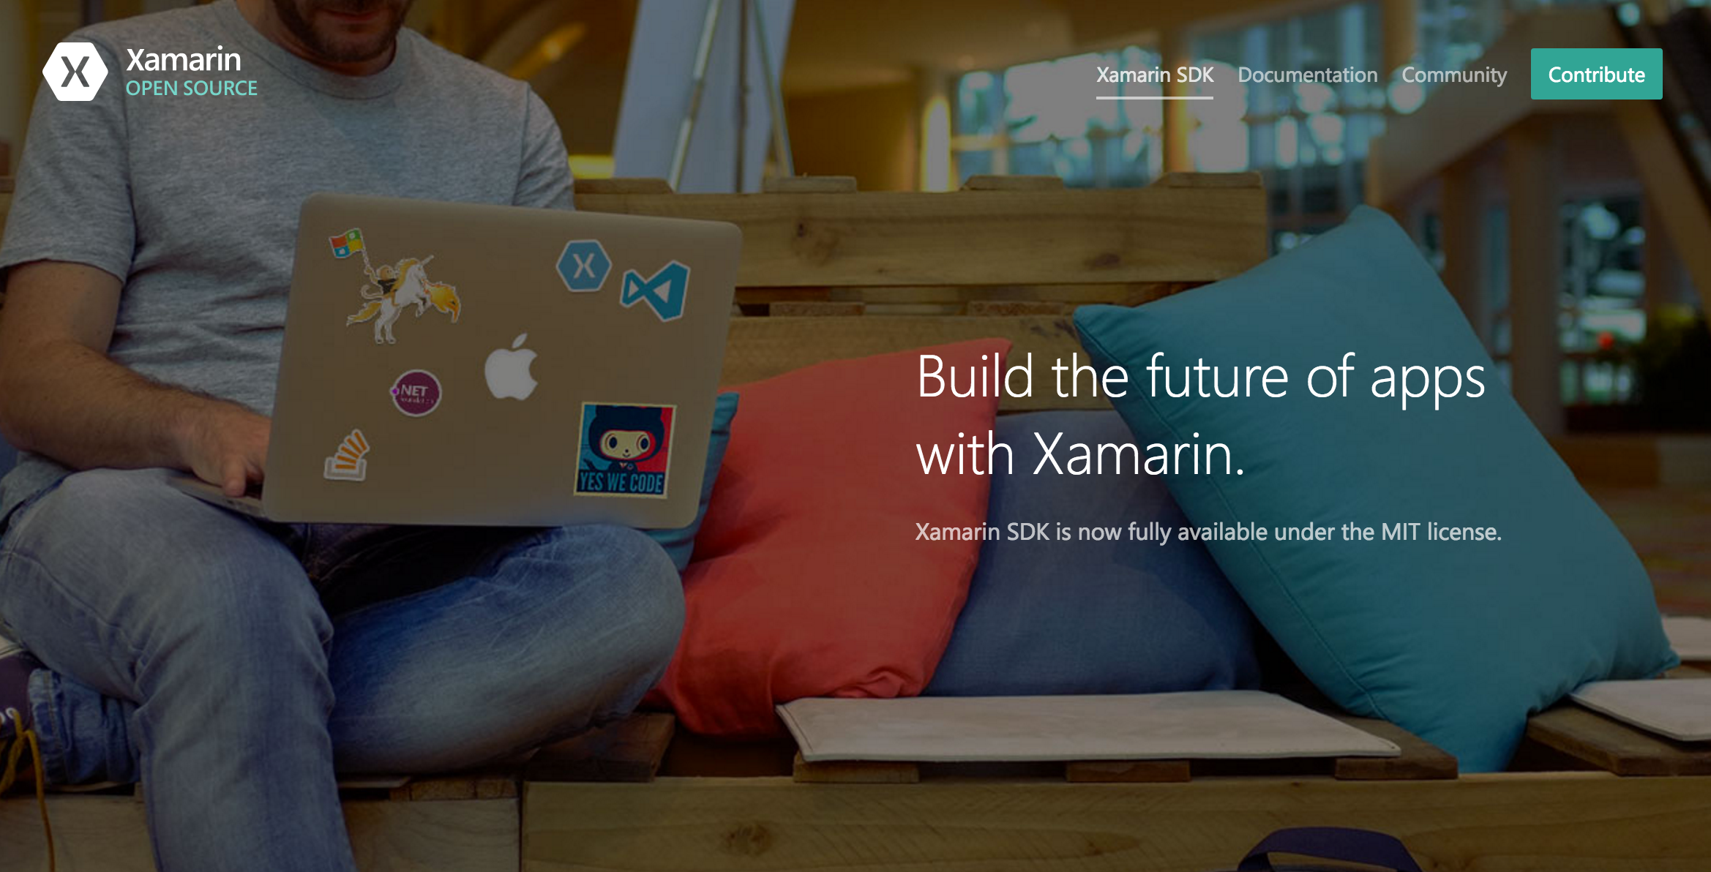
Open Source – open.xamarin.com

Slide 22
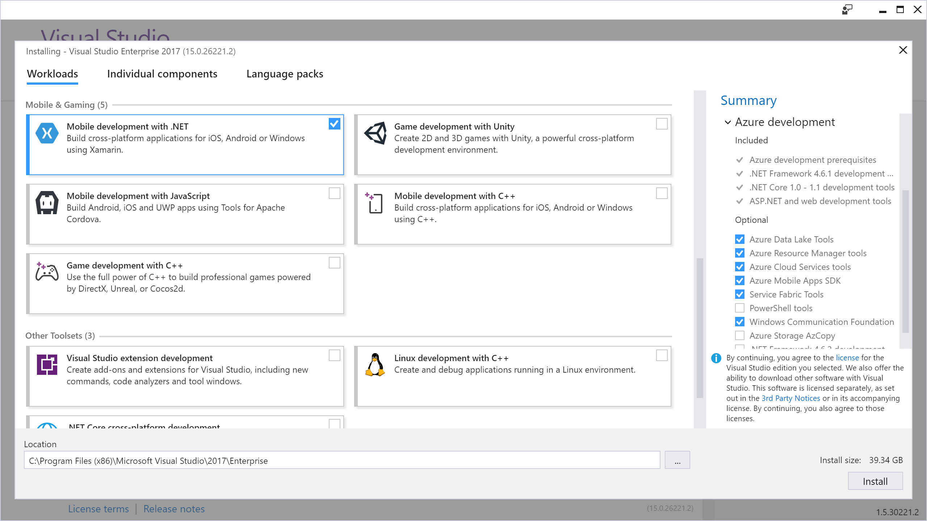
Visual Studio Integration
Xamarin.com/Download

Slide 23
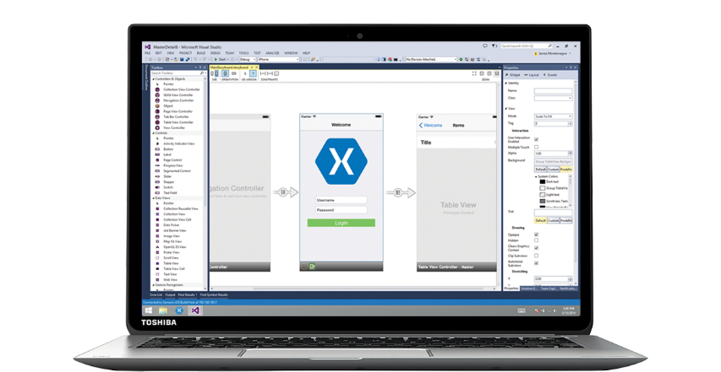
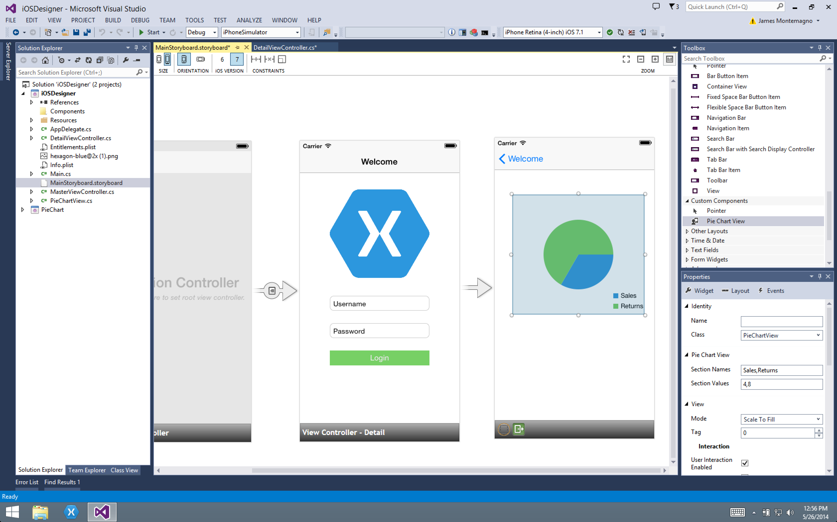
Xamarin for Visual Studio

Slide 24
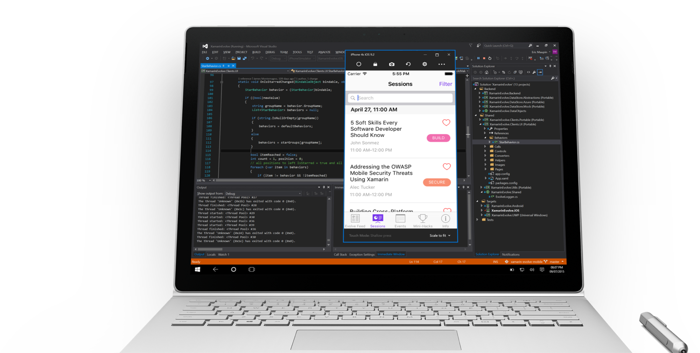
Visual Studio iOS Simulator Remoting
Multi-Touch Enabled
Pressure Sensitive
Super Fast
Rotate, screenshots, location changes
Never leave VS
*Requires Visual Studio Enterprise

Slide 25

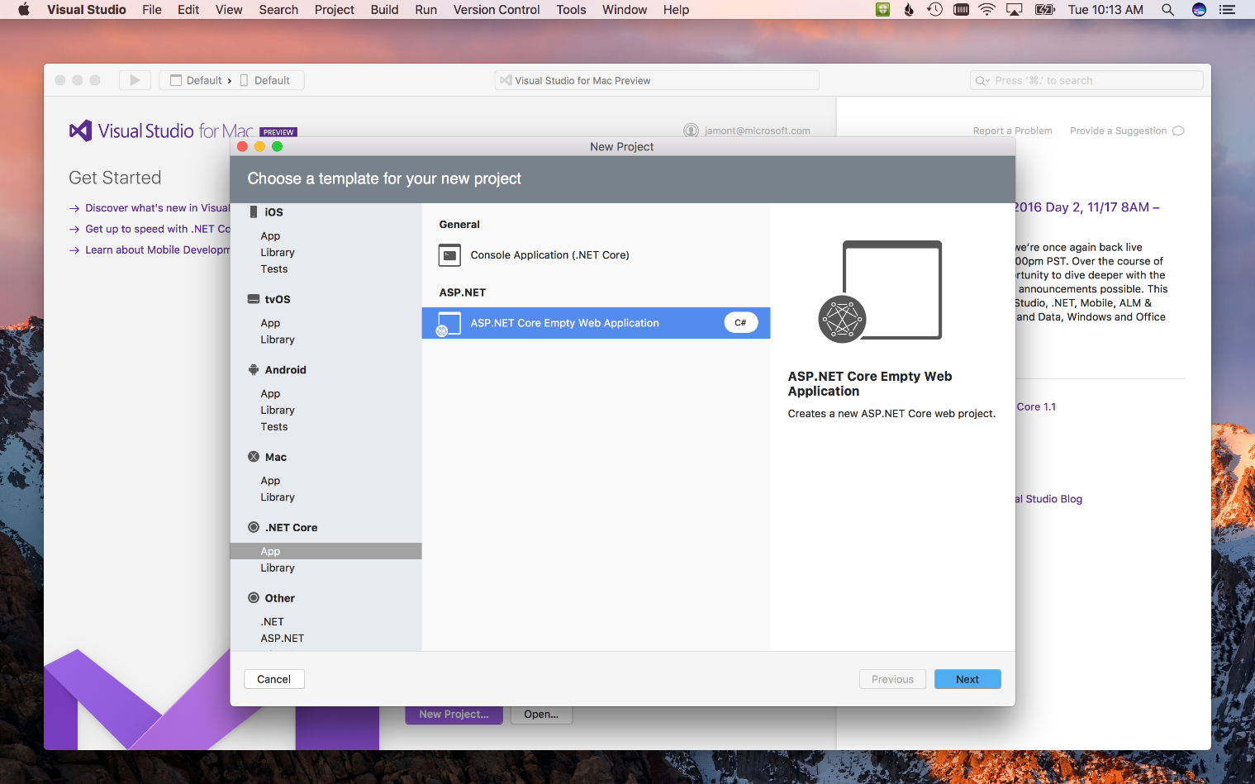
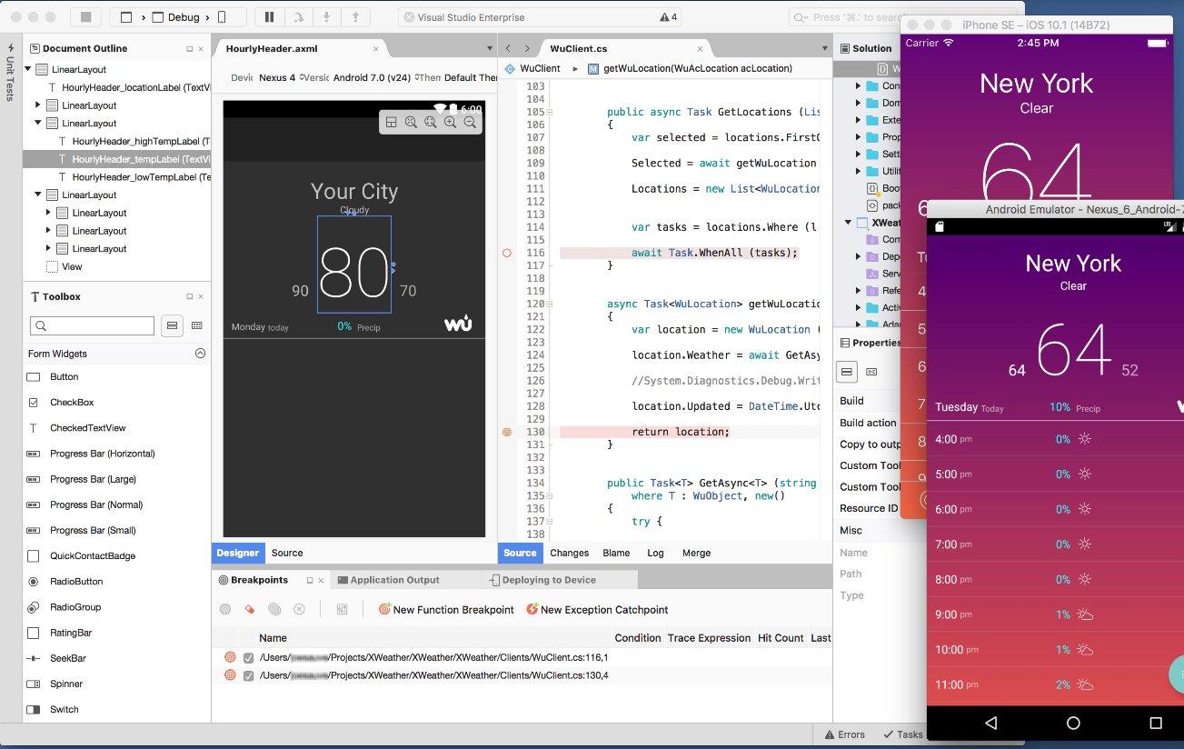
Visual Studio for Mac
iOS, Android, & macOS
.NET development
.NET Core & ASP.NET Core
Tools for Azure
Unity Game Development
Azure Functions
IoT
Docker

Slide 26
Streamlined Development

Slide 27
Shared C# Backend

Slide 28
Platform Specific Code
UI+APIs
UI + APIs
UI + APIs
Battery
GPS
Lights
Notifications
Settings
Text To Speech
Battery
GPS
Lights
Notifications
Settings
Text To Speech
Battery
GPS
Lights
Notifications
Settings
Text To Speech
What if we didn’t have to write this code?
What if we could access it from shared code?

Slide 29
Speak(“Hello World”);
AVSpeechSynthesizer
TextToSpeech
SpeechSynthesizer

Slide 30
Plugins for Xamarin & Windows
Xamarin.com/plugins
Common API

Slide 31
Let’s use a Plugin for Xamarin

Slide 32





Microsoft’s complete mobile DevOps solution
Develop
Test
Build
Distribute
Monitor

Slide 33
Live Update
Crash Reporting
A/B Testing
Storage
Identity
Push Notifications
Remote Config.
Tables

Slide 34
Visual Studio Mobile Center
A/B Testing
Push Notifications
Crash Reporting
Remote Config.
Identity
mobile.azure.com
Tables
Live Update
Storage

Slide 35
15 Minute Break
Presenter First Name
Presenter Last Name
Presenter Title
Presenter e-mail
blogs
Twitter

